Slide 1


Module 2
COMPUTER ARCHITECTURE
STATE POLYTECHNIC OF MALANG

Slide 2
Group 3
COMPARISON
SAMSUNG GALAXY A20 & SAMSUNG GALACY M20
Arlan Ady Pratama (5)
Mochammad Syaifuddin Zuhri (17)
Sesha Dwi Lestari (27)

Slide 3
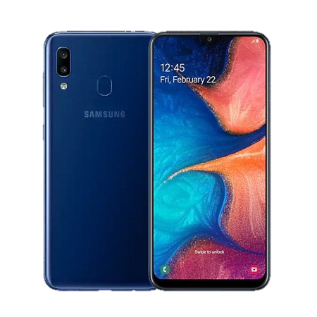
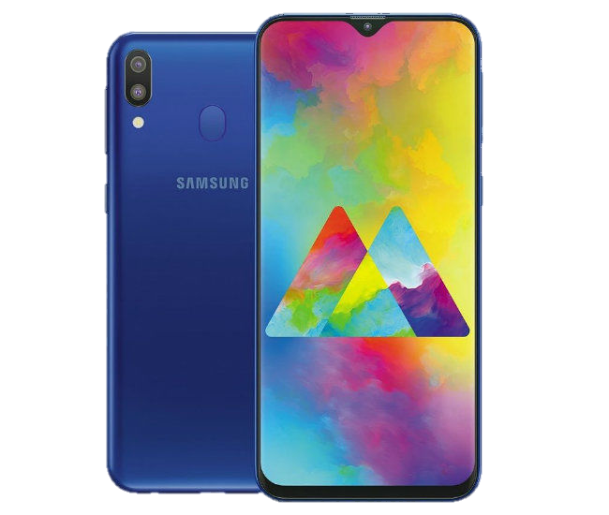
Samsung
Galaxy A20
Samsung
Galaxy M20
VS

Slide 4
Samsung Galaxy A20
Samsung Galaxy M20
Display
6.4” (1.560 x 720 pixels)
6.3” (2.340 x 1.080 pixels)
Storage
32 GB (up to 512 GB)
32 GB (up to 512 GB)
RAM
3 GB
3 GB
Camera
13 MP + 5 MP + 8 MP
13 MP + 5 MP + 8 MP
Processor
Exynos 7884 octa-core chip with a speed of 1.6 GHz
Exynos 7904 octa-core chip with a speed of 1.8 GHz
Battery
4.000 mAh
5.000 mAh
Operating System
Android 9.0 (Pie)
Android 8.1 (Oreo)
Dimession
158.4 x 74.7 x 7.8 mm
156.4 x 74.5 x 8.8 mm
Price
Rp. 2.300.000
Rp. 2.500.000

Slide 5


1
Samsung Galaxy M20 screen size is smaller than Samsung Galaxy A20
2
Samsung Galaxy M20 processor speed is faster than Samsung Galaxy A20

Slide 6
3
Samsung Galaxy A20 screen size is greater than Samsung Galaxy M20
4
Samsung Galaxy A20 processor speed is slower than Samsung Galaxy M20

Slide 7


5
Samsung Galaxy M20 battery capacity is greater than Samsung Galaxy A20
6
Samsung Galaxy A20 operating system is more recent than Samsung Galaxy M20

Slide 8

7
Samsung Galaxy A20 battery capacity is smaller than Samsung Galaxy M20
8
The price of Samung Galaxy A20 is cheaper than Samsung Galaxy M20

Slide 9

9
Samsung Galaxy A20 dimensions and weight is greater than Samsung Galaxy M20
10
The price of Samung Galaxy M20 is more expensive than Samsung Galaxy A20

Slide 10
THANK YOU
QUESTION?
COMPARISON
VS
Galaxy A20
Galaxy M20

